Slide 1
EAS2655 – Week 11
Agenda
Geochemical box model (e.g., atmospheric chemistry model)
Basic concepts and terminology
Ordinary differential equations (ODE)
One-box model for CO2
Numerical solution
Reading p. 78-84

Slide 2
EAS2655 – Week 11
What is a model?
A model is a simplified representation of a complex system enabling prediction of the system behavior within acceptable error.

Slide 3
EAS2655 – Week 11
Improve model, characterize its error
Design model; make assumptions needed
to simplify equations and make them solvable
Design observational system to test model
Define problem of interest
Evaluate model with observations
Apply model:
make hypotheses, predictions
“All models are wrong, but some are useful”

Slide 4
EAS2655 – Week 11
Example: build a model for a chemical species X in the atmosphere
What processes control atmospheric concentrations?
3. Chemical
production
2. Transport
4. Chemical loss
X
X
5. Deposition
1. Emission
Land & ocean surface

Slide 5
EAS2655 – Week 11
One-box atmospheric chemistry model:
A “box”: spatial distribution of X within box is not resolved
Chemical
production
Chemical
loss
P
L
The box can be global atmosphere or a subdomain
Inflow
Outflow
X
F_{out}
F_{in}
E
D
Emission
Deposition

Slide 6
EAS2655 – Week 11
One-box atmospheric chemistry model:
∑Sources = F_{in} + E + P
Chemical
production
Chemical
loss
∑Sinks = F_{out} + D + L
P
L
Inflow
Outflow
X
F_{out}
F_{in}
E
D
C: concentration of X (ppmv, pptv)
m: total mass of X in the box (kg, Tg, Pg)
Source and sink terms are rates:
mass/time (e.g., Pg/year)
concentration/time (e.g., ppmv/year)
Emission
Deposition

Slide 7
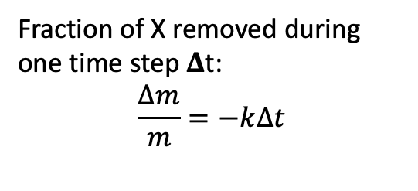
EAS2655 – Week 11
One-box atmospheric chemistry model:
Chemical
production
Chemical
loss
P
L
Inflow
Outflow
X
F_{out}
F_{in}
E
D
Fraction of X removed during one time step 𝚫t:
$$\frac{∆m}{m}=−k∆t$$
Emission
Deposition

Slide 8

EAS2655 – Week 11
Change of the mass of X within one time step:
$$∆m=\left(F_{in}+E+P\right)∆t−(F_{out}+L+D)∆t$$
$$∆m/∆t=(input)−(output)$$
Differential equation form:
$$\frac{dm}{dt}=(input)−(output)$$
There is only one independent variable (t), so it is an ordinary differential equation (ODE).

Slide 9
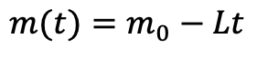
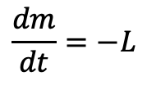
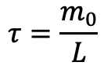
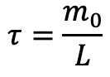
EAS2655 – Week 11
Special case 1: no source, constant loss L, initial mass m₀, initial time 0
$$\frac{dm}{dt}=−L$$
$$m(t)=m_{0}−Lt$$
m
m₀
Lifetime:
$$τ=\frac{m_{0}}{L}$$
t
$$τ=\frac{m_{0}}{L}$$

Slide 10
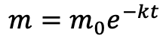
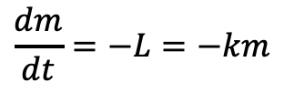
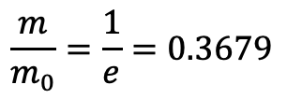
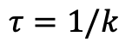
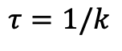
EAS2655 – Week 11
Special case 2: no source, first-order loss L=km, initial mass m₀ , initial time 0 (e.g., CFCs)
$$\frac{dm}{dt}=−L=−km$$
$$m=m_{0}e^{−kt}$$
m
m₀
Lifetime:
$$τ=1/k$$
$$\frac{m}{m_{0}}=\frac{1}{e}=0.3679$$
$$τ=1/k$$
t

Slide 11
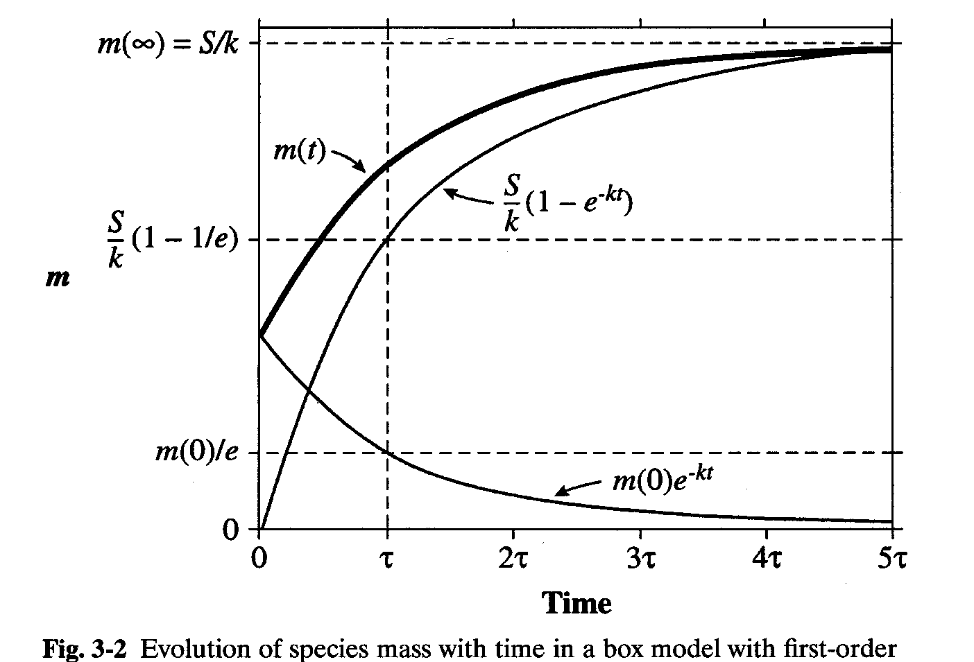
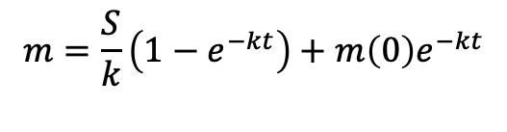
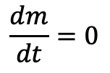
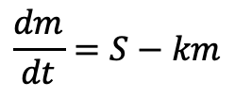
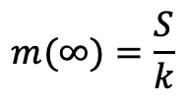
EAS2655 – Week 11
Special case 3: constant source (S), first-order loss L=km, initial mass m₀
$$\frac{dm}{dt}=S−km$$
$$m=\frac{S}{k}\left(1−e^{−kt}\right)+m\left(0\right)e^{−kt}$$
Initial condition, t=0: m=m(0)=m₀
Lifetime, 𝛕 =1/k
Steady state (t>>𝛕):
$$m(∞)=\frac{S}{k}$$
$$\frac{dm}{dt}=0$$
$$m=m\left(∞\right)+[m\left(0\right)−m\left(∞\right)]e^{−t/τ}$$

Slide 12
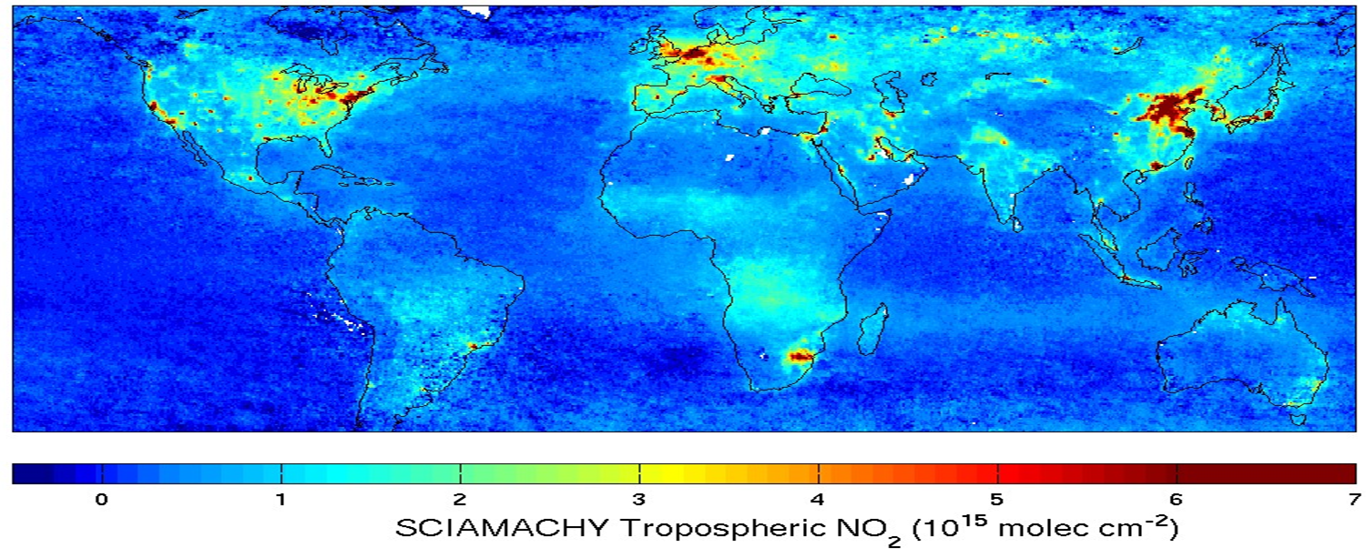
Nitrogen dioxide (NO₂) has atmospheric lifetime ~ 1 day: strong gradients away from combustion source regions
EAS2655 – Week 11
Why lifetime matters?
Satellite observations of NO₂ columns

Slide 13
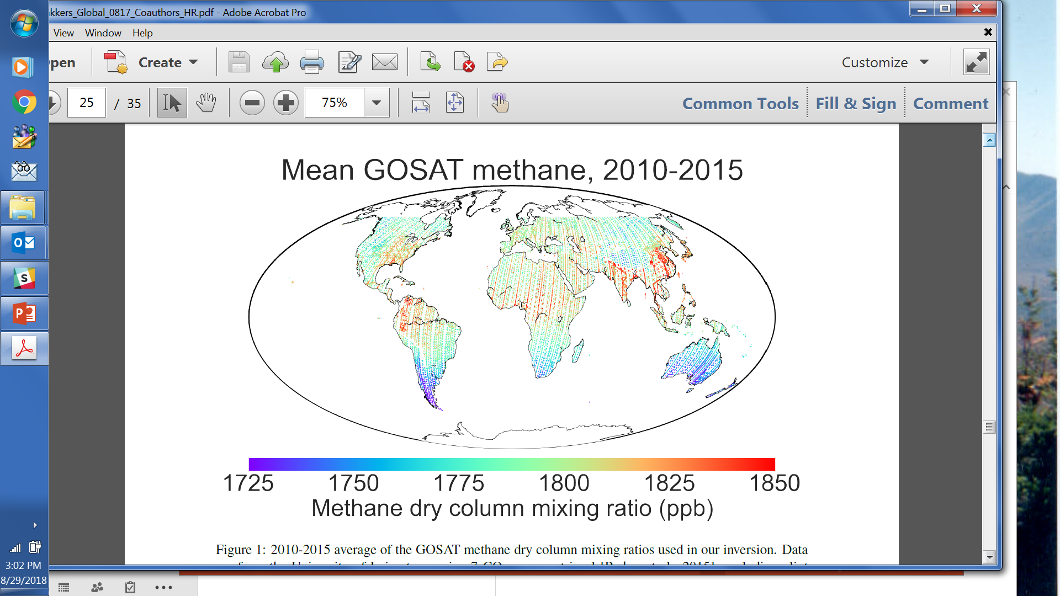
EAS2655 – Week 11
Why lifetime matters?
Methane (CH4) has atmospheric lifetime of 10 years: global mixing
GOSAT satellite observations

Slide 14
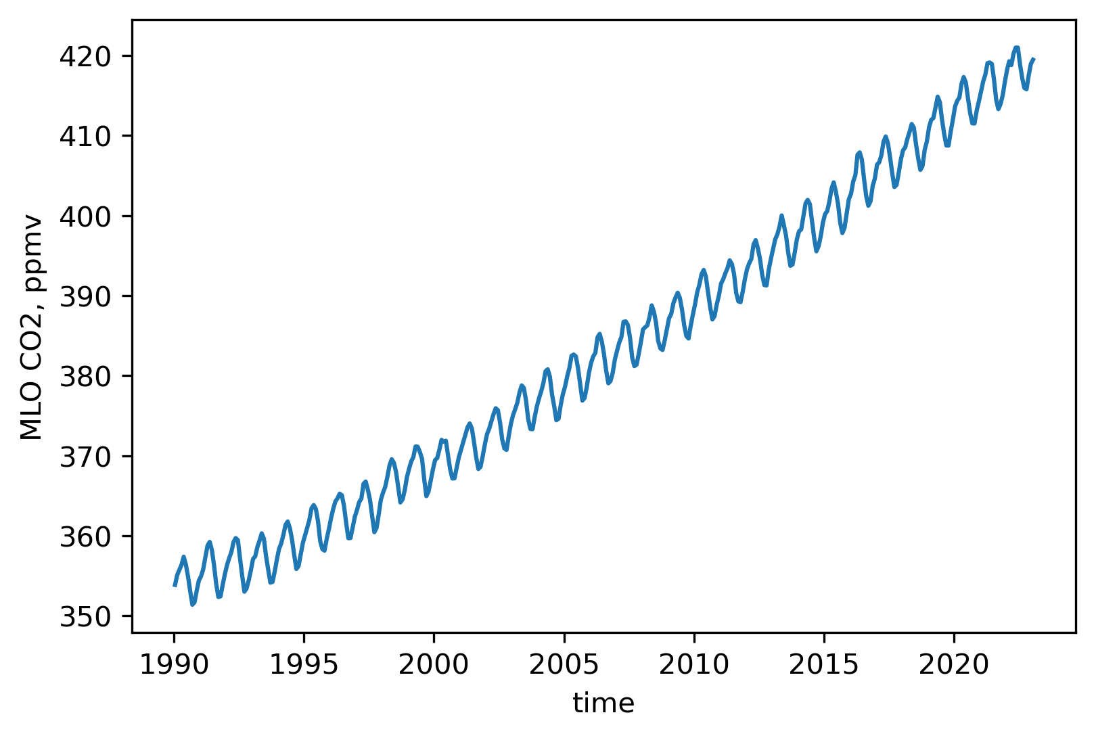
EAS2655 – Week 11
Carbon dioxide (CO2) has atmospheric lifetime of 300-1000 years: global mixing
Atmospheric CO2 concentration measured
at Mauna Loa observatory
How do we build a model for CO2?
Global mixing: one box for the atmosphere
Sources:
Fuel combustion
Respiration
Sinks:
Photosynthesis
Ocean uptake
Same dataset used in week 6

Slide 15
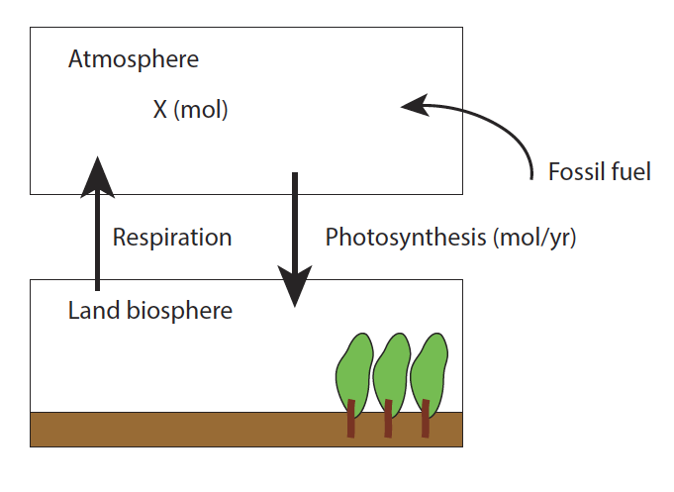
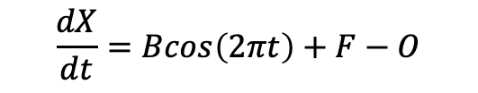
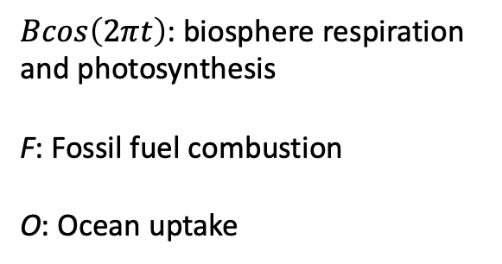
EAS2655 – Week 11
Ocean uptake
Differential equation:
$$\frac{dX}{dt}=Bcos\left(2πt\right)+F−O$$
$Bcos\left(2πt\right)$: biosphere respiration and photosynthesis
F: Fossil fuel combustion
O: Ocean uptake

Slide 16

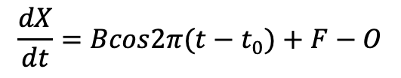
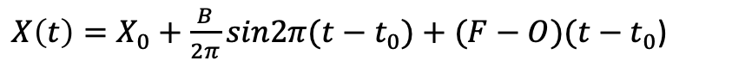
EAS2655 – Week 11
Differential equation:
Units:
X (ppmv)
B, F, O (ppmv/year)
$$\frac{dX}{dt}=Bcos2π(t−t_{0})+F−O$$
Initial condition:
$$X\left(t=t_{0}\right)=X_{0}$$
Analytical solution:
$X\left(t\right)=X_{0}+\frac{B}{2π}sin2π(t−t_{0})+(F−O)(t−t_{0}$)

Slide 17

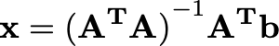
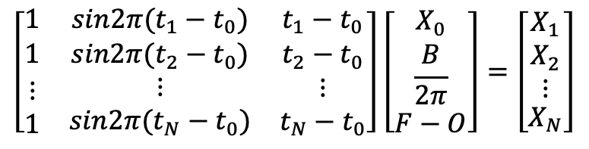
EAS2655 – Week 11
Estimate parameters using MLR:
$X\left(t\right)=X_{0}+\frac{B}{2π}sin2π(t−t_{0})+(F−O)(t−t_{0}$)
T = [t₁ t₂ t₃ ･ ･ ･ t_{N}]^{T}
X = [x₁ x₂ x₃ ･ ･ ･ x_{N}]^{T}
$$\left[\begin{matrix}1 & sin2π(t_{1}−t_{0}) & t_{1}−t_{0} \\ 1 & sin2π(t_{2}−t_{0}) & t_{2}−t_{0} \\ \begin{aligned}⋮ \\ 1\end{aligned} & \begin{aligned}⋮ \\ sin2π(t_{N}−t_{0})\end{aligned} & \begin{aligned}⋮ \\ t_{N}−t_{0}\end{aligned}\end{matrix}\right]\left[\begin{matrix}X_{0} \\ \frac{B}{2π} \\ F−O\end{matrix}\right]=\left[\begin{matrix}X_{1} \\ \begin{aligned}X_{2} \\ ⋮\end{aligned} \\ X_{N}\end{matrix}\right]$$
A x = b
Pseudo inverse:

Slide 18
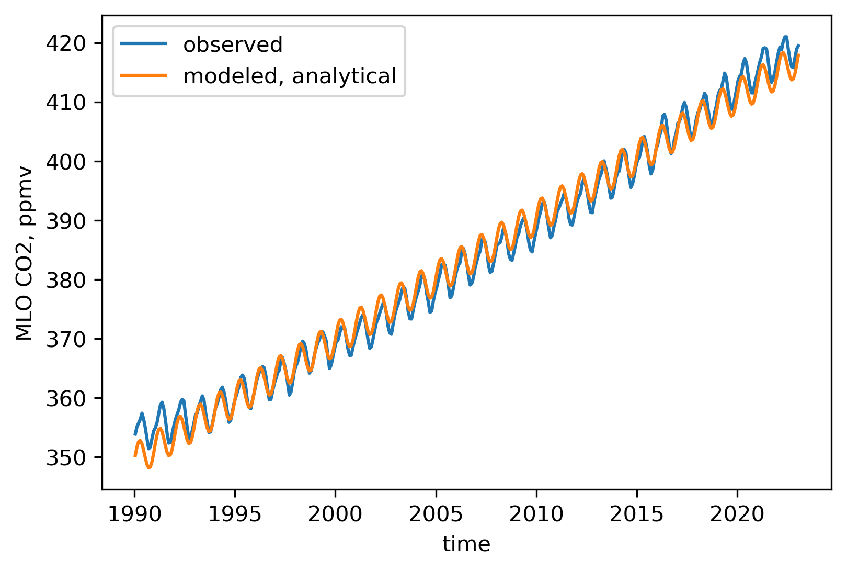
EAS2655 – Week 11
Estimate parameters using MLR (top-down):
$X\left(t\right)=X_{0}+\frac{B}{2π}sin2π(t−t_{0})+(F−O)(t−t_{0}$)
Interpretation:
Simple 1-box model with constant B, F and O can well capture the seasonal cycle and general increasing trend;
Discrepancies remain as the increasing trend of CO2 is accelerating.
Estimated parameters:
X₀ = 349.432 ppmv
B/2π = 2.837 ppmv
F-O= 2.049 ppmv/year

Slide 19
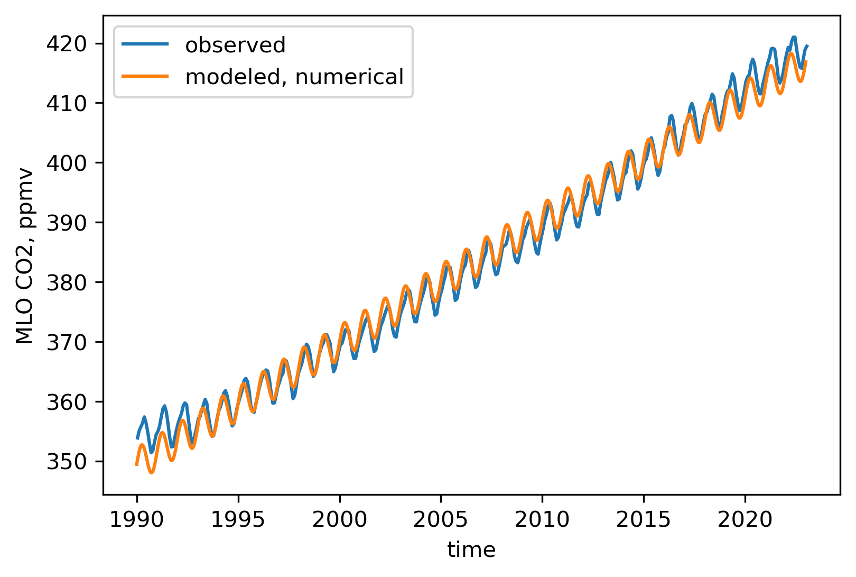
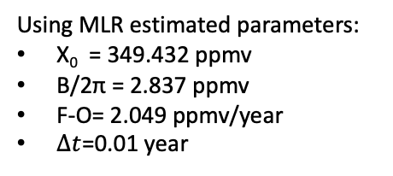
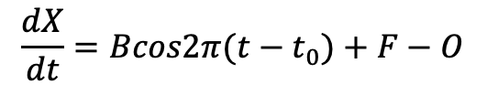
EAS2655 – Week 11
Numerical solution:
$$\frac{dX}{dt}=Bcos2π(t−t_{0})+F−O$$
$$X_{n+1}=X_{n}+[Bcos2π(t−t_{0})+F−O]∆t$$
Using MLR estimated parameters:
X₀ = 349.432 ppmv
B/2π = 2.837 ppmv
F-O= 2.049 ppmv/year
$∆t$=0.01 year

Slide 20
EAS2655 – Week 11
Model vs observation
Constant F-O does not fully capture the CO2 increasing trend
Improve model, characterize its error
Design model; make assumptions needed
to simplify equations and make them solvable
Design observational system to test model
Define problem of interest
Evaluate model with observations
Apply model:
make hypotheses, predictions

Slide 21
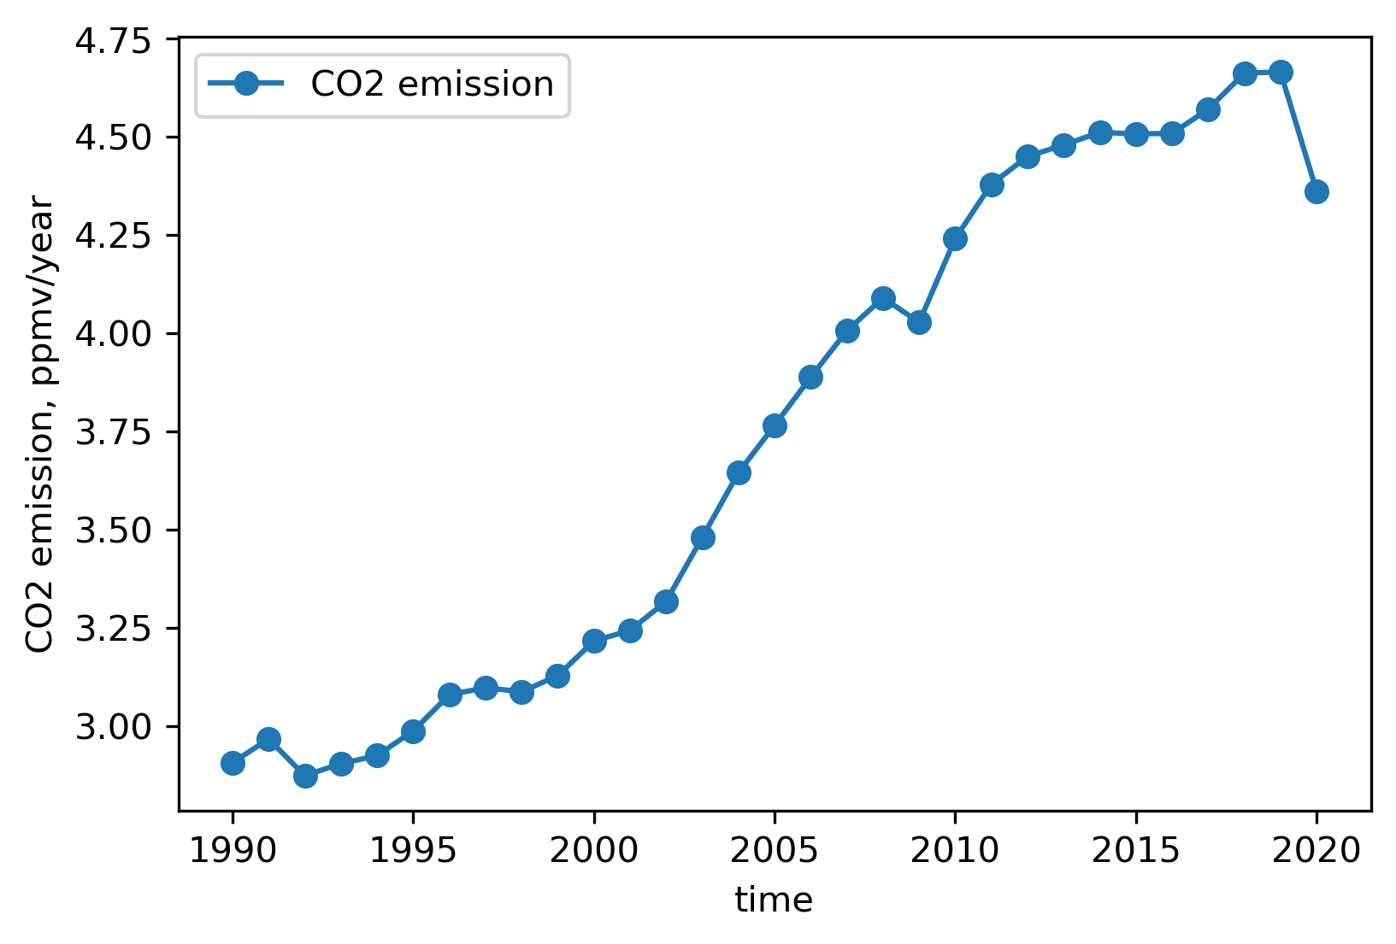
EAS2655 – Week 11
Original CO2 emission data has the unit of billion Tonnes CO2 /year (10^12 kgCO2/year)
To convert the unit into ppmv/year:
(E*10^12) (kgCO2/year)/5.148e18 kg air*[29 (g air/mol)/44 (gCO2/mol)]*1e6 (ppmv)
Model improvement
Take realistic CO2 emission data
Data source: https://ourworldindata.org/co2-emissions#global-co2-emissions

Slide 22
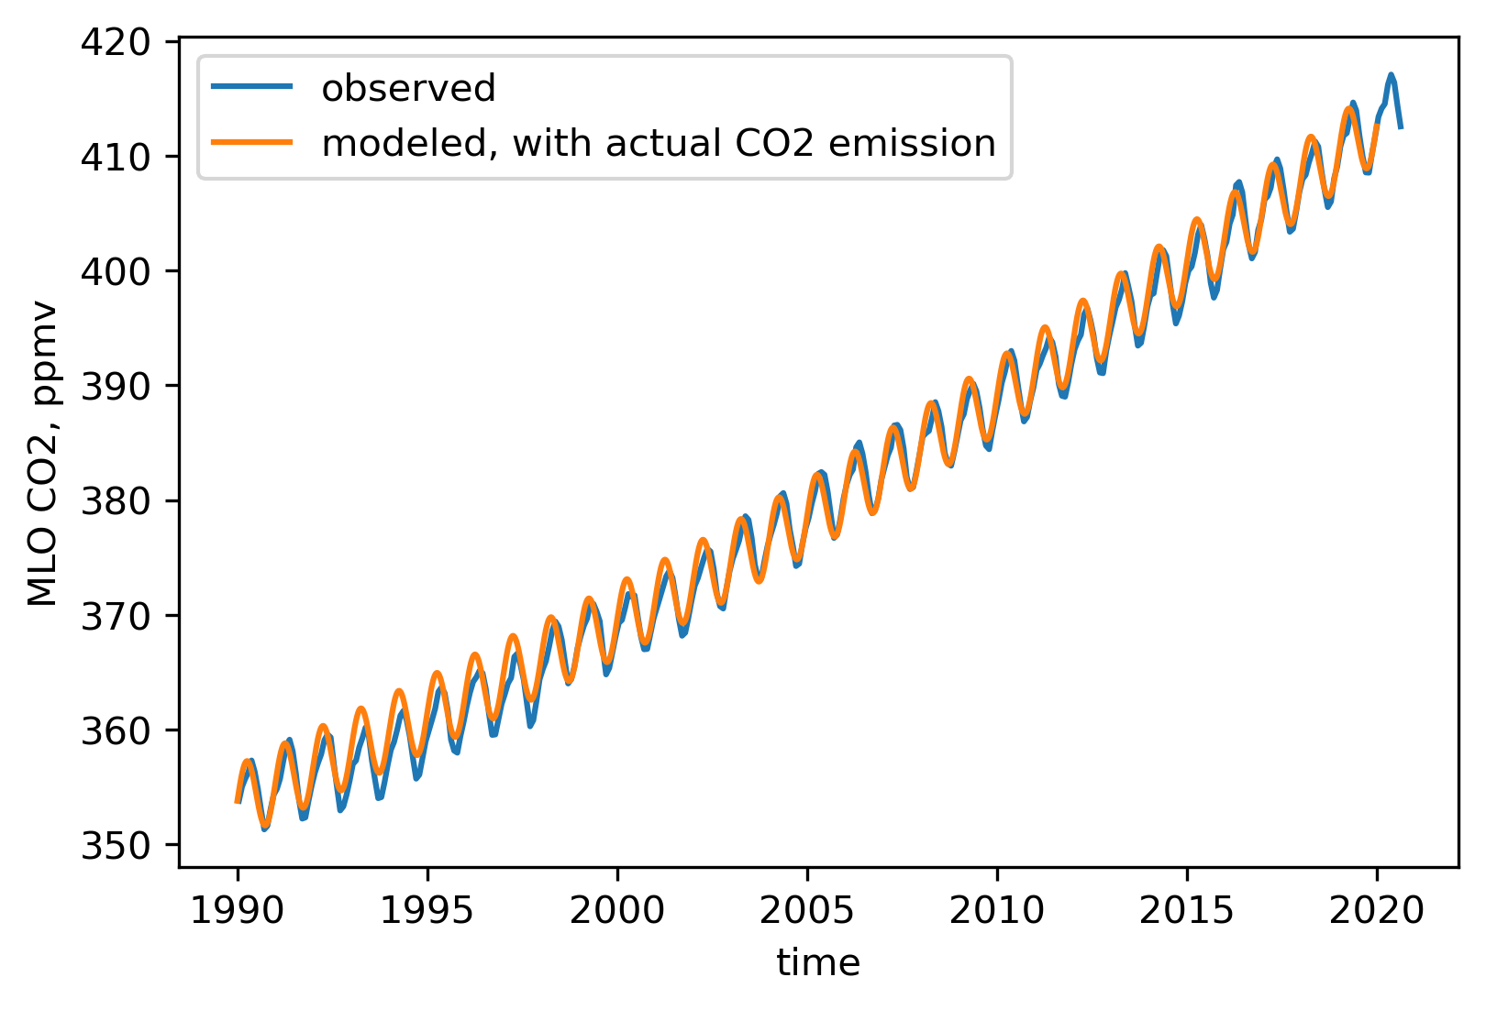
EAS2655 – Week 11
Model improvement
Taking realistic CO2 emission data
Improved agreement between model and observations
F values taken from actual CO2 emission data
t0=1990
X0=353.86
B=20
O=0.475*F

Slide 23
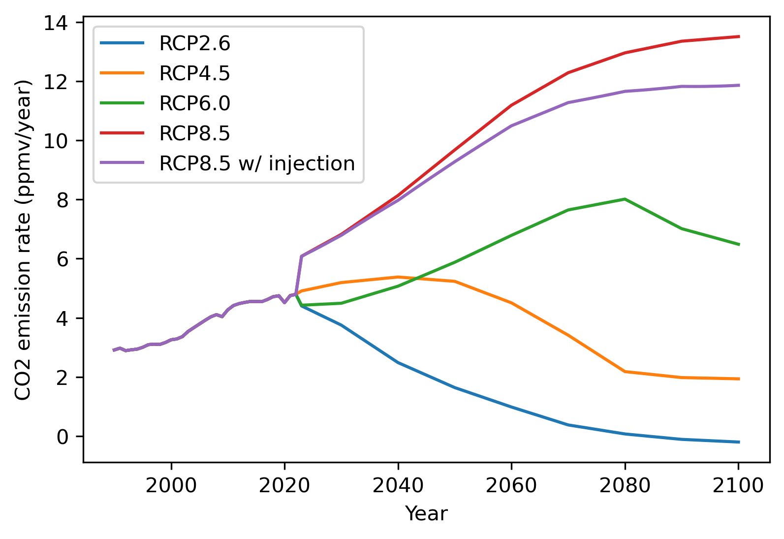
EAS2655 – Week 11
Make predictions for future CO2 concentration (Homework)
Future CO2 emission scenarios: taken from Representative Concentration Pathways (RCPs) in IPCC’s AR5 report
RCP8.5 (business as usual) + CO2 injection

Slide 24
EAS2655 – Week 11 (HW, Due April. 7)
Make predictions for future CO2 concentration (Homework)
Future CO2 emission scenarios: Representative Concentration Pathways (RCPs)
Using our one-box model, with parameters trained by MLO observations from 1990-2020
t0=1990, X0=353.8, B=20, O=0.475*F
F is dynamically updated based on emission input
Pick a RCP scenario, calculate the atmospheric CO2 concentration from 1990 to 2099 using the box model
Plot your prediction of atmospheric CO2 concentration for the 21st century. Label which RCP scenario you are using.

Slide 25
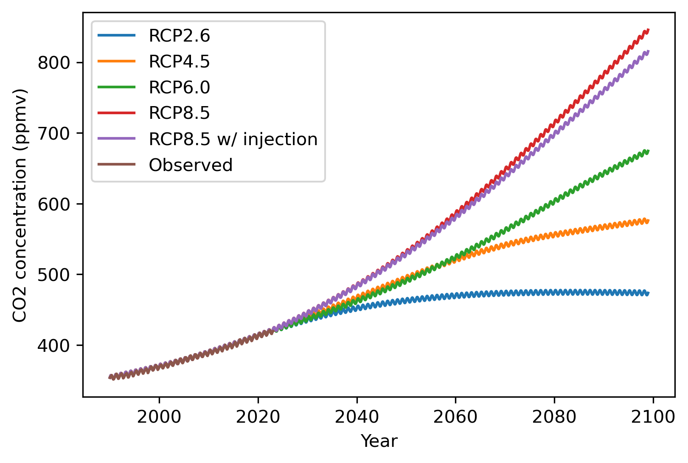
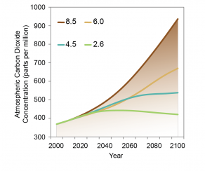
EAS2655 – Week 11 (HW)
Box-model predictions
True RCP CO2 concentrations
In the HW, you don’t need to show all four RCP scenarios. Just pick one and label which one you are using.

